Slide 1






Bacchus Winery Case Study

Slide 2


Alpha Team
Daniel Graham
Aidan Jacoby
Stephanie Ramos

Slide 3
Bacchus Winery Case Study Overview
Bacchus Winery is a family-owned business, recently inherited by Stan and Davis Bacchus from their father, George.
The brothers aim to modernize operations while keeping the current staff in place.
The winery produces four types of wine: Merlot, Cabernet, Chablis, and Chardonnay.
Materials are sourced from multiple suppliers.
Key challenges include:
Tracking supplier delivery performance
Improving inventory management
Enabling online ordering and shipment tracking for distributors
Evaluating employee work hours
Analyzing sales performance by wine type and distributor

Slide 4
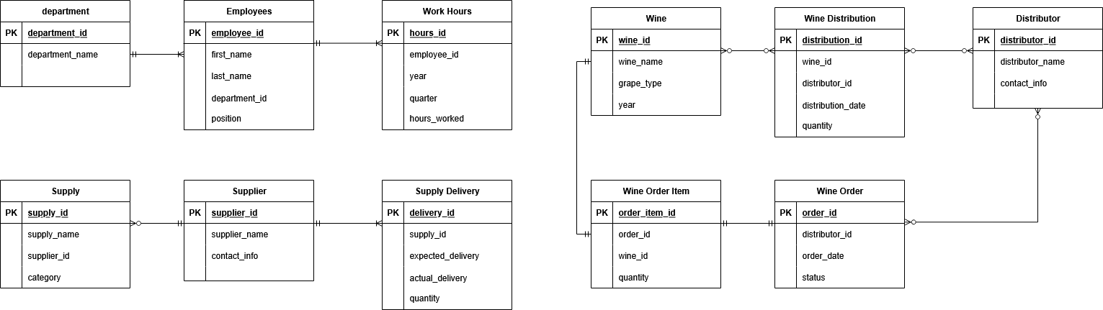
Finalized ERD

Slide 5

Report Objectives
Supplier Delivery Report – Are all suppliers delivering on time?
Wine Distribution Report – Are all wines selling?
Employee Work Report – How long is our team working?

Slide 6
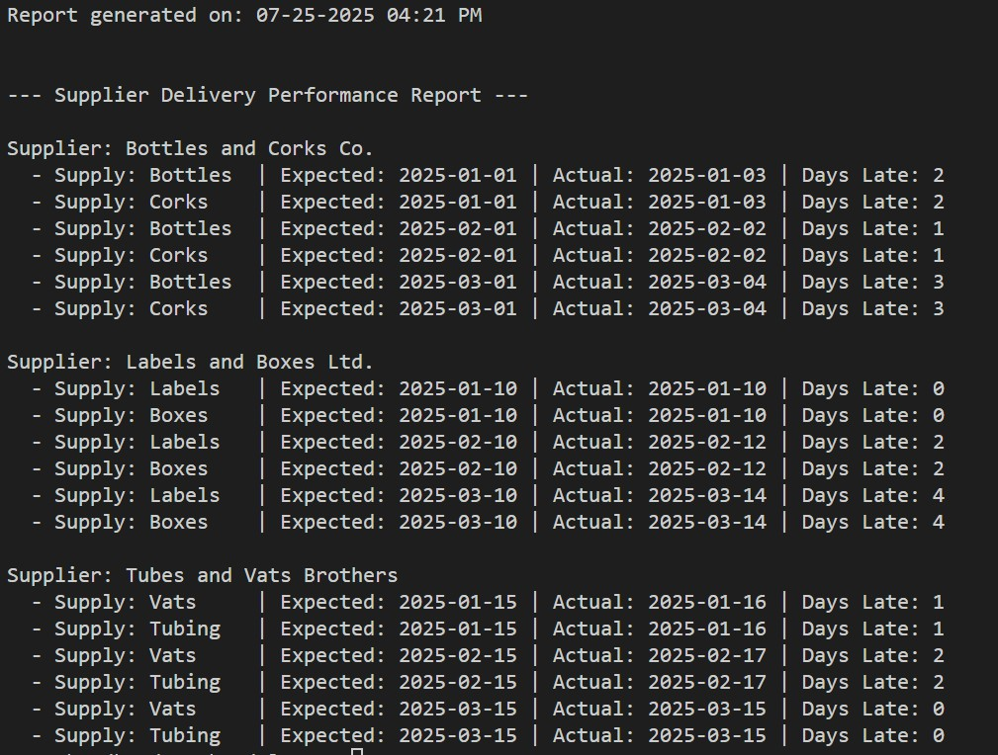
Supplier Delivery Report
Description:
This report evaluates whether each supplier is delivering their supplies on time. It shows expected vs. actual delivery dates for each item shipped monthly and calculates how many days late the deliveries were. This helps identify consistent delays and potential supply chain issues.
Assumptions:
Each supplier delivers all their items once per month.
All supplies from a supplier are shipped together each month.

Slide 7
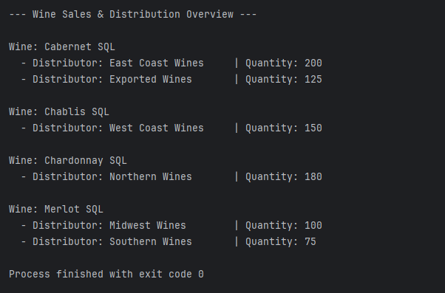
Wine Sales & Distribution Report
Description:
This report tracks the quantity of wine sold each month, by wine type and distributor. It helps determine which wines are most popular and which distributors are selling the most, supporting future marketing and production decisions.
Assumption:
Each wine has at least one distributor; some may have more than one.
Distributors sell all or only some of the available wine types

Slide 8
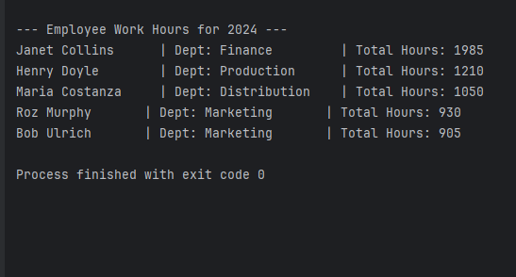
Employee Work Hours Report
Description:
This report shows hours worked by each employee, grouped by department. It helps management monitor labor distribution across departments and prepare quarterly workforce reports.
Assumptions:
Employees are full-time and work is tracked weekly.
Each employee is assigned to one department.
Existing employees remained employed and were added to the system with assigned employee IDs.

Slide 9

Thank You
Bacchus Winery

